Slide 1


A wind tunnel for kids…
Status Update
March 1, 2012

Slide 2
Activities this week
Hardware development
Wiring / Board layout (pictures provided)
Android development
Implemented trend plotting tools (video provided)
Generated more Javadoc developer documentation

Slide 3
Baseline Documentation Metrics
Metric | Value | Notes
# Developer Documents | 116 | SoW, SDP, SRS, SDD, Fall FQT, Javadocs
# Administrator Documents | 0
# Pages | 47
# Status Presentation Slides | 114

Slide 4
Baseline Code Metrics
Metric | Value | Notes
SLOC (Physical) | 9574
SLOC (Logical) | 7025
# Source Files | 112 | File types included: .h, .cpp, .java, .xml, .pde, .ino

Slide 5
Baseline Hardware Metrics
Metric | Value | Notes
# Sensors Prototyped | 3 | Temperature, Humidity, Hall Effect
# Control Elements Prototyped | 2 | Motor Control, LED
# Sensors Integrated | 1 | Hall Effect
# Control Elements Integrated | 1 | Motor Control

Slide 6
Arduino Development
Video
http://youtu.be/HrSJLhGlStc
Shows time history plotting capabilities in our Android client

Slide 7
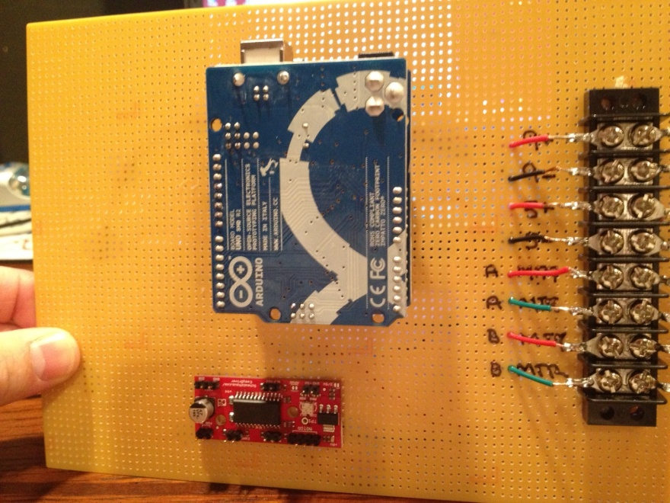
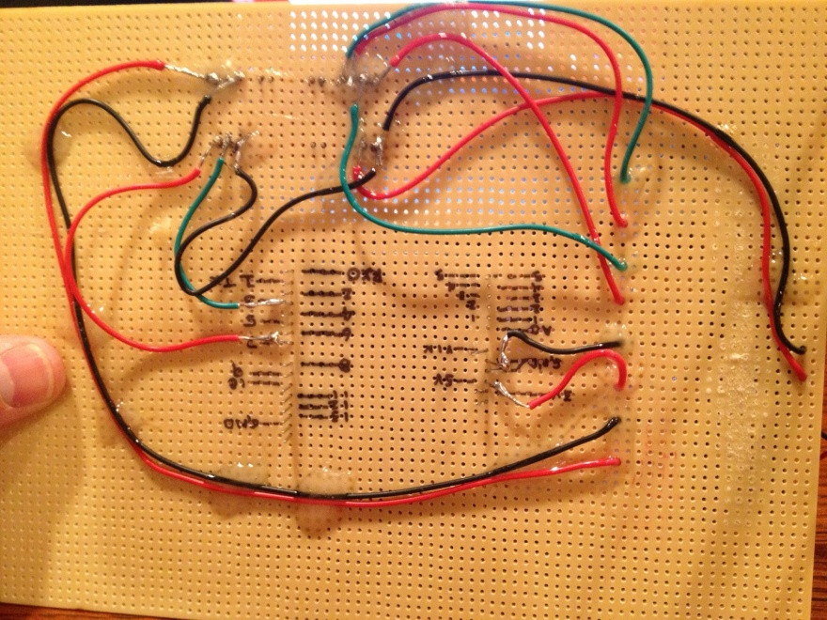
Hardware Development
Board layout work progressed this week.

Slide 8


Follow us on Twitter… 7 followers – 47 tweets
@TunnelK
Notes:
Initial social network of choice…

